Slide 1
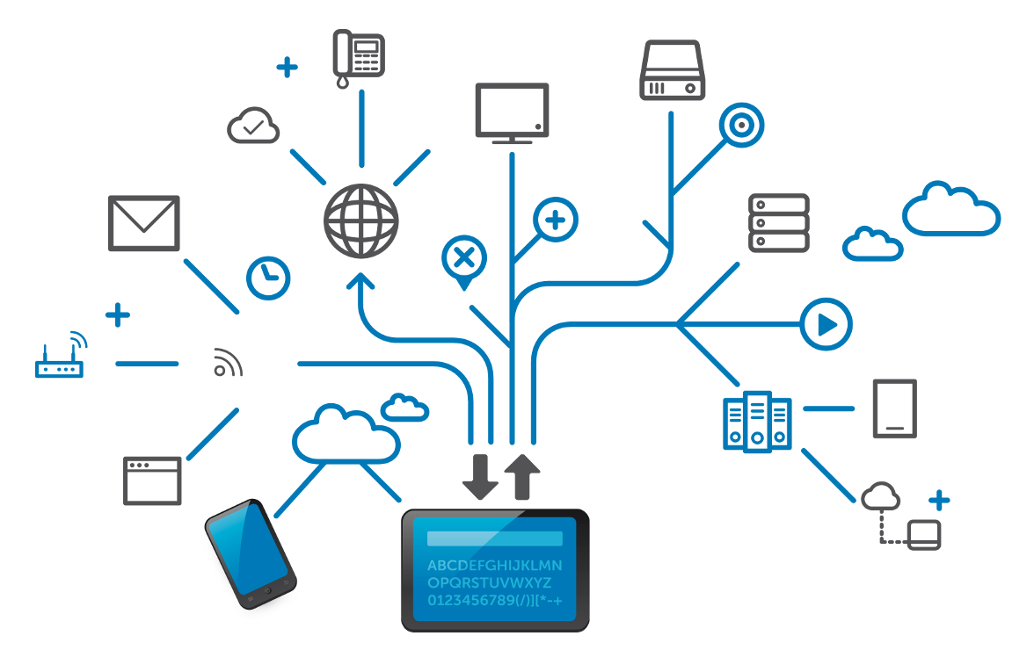
NETWORK FUNDAMENTALS

Slide 2
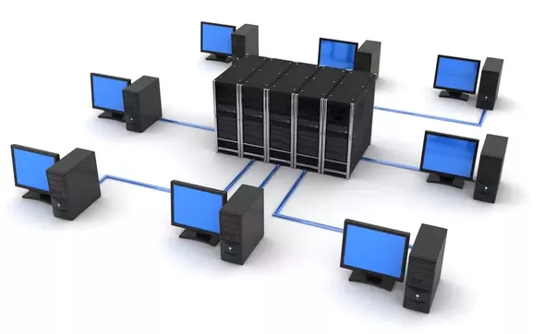
What is a Network ?
A computer network is a digital telecommunication network which allow nodes to share resources.
Two or more computers connected together

Slide 3
How network supports the way we LIVE ?
Early communication relies on face-to-face conversation.
With advances in society, other means of communication emerged :
Mail (written message).
Telephone (voice).
Television broadcast (one-way video communication).
With the use of the Internet, all the different types of communication are converging into Web-based communication.

Slide 4
Current networks have evolved in mainly two ways:
They can carry various types of information: text, graphics, voice, video streams.
They can support different types of devices: computers, PDAs, mobile phones, webcams, refrigerator, microwave (pretty anything you can think of…).
The Internet nowadays is used in various ways:
Receive and send email
Obtain information and advice
Online shopping and selling / auction
Electronic banking …………………………….etc.

Slide 5
How network supports the way we LEARN ?
The Internet can enhance learning and makes it easier in several ways:
Distribution of content
Availability of various resources
Remote learning (enable learning to be done from any location)
E-learning - Courses delivered using Internet resources. Its benefits include:
Easy update of learning materials
Availability to a wide audience
Consistent quality of instruction
Cost reduction

Slide 6
How network supports the way we WORK ?
Proper use of network can enhance communication between employees in an organization and also with external clients.
INTRANET :
A private network belonging to the company.
Allows communication between employees and also between branches.
EXTRANET :
A network to provide suppliers, vendors or customers, some limited access to corporate data.
Examples of common data to be shared: order status, inventory, parts lists.

Slide 7
VPN (Virtual Private Network)
It allows employees to access company’s intranet remotely.
Work can be done even though the employee is outstation or at home.
Working from Home
No longer need to go to the office every day.
Communications with other employees or clients can be done online.
Can work and take care of family at the same time.

Slide 8
How network supports the way we PLAY ?
Entertainment is also enhanced by the use of network, say:
Chatting and instant messaging
Online interest groups
Web blogging
Video and audio streaming
Online games

Slide 9
What is COMMUNICATION ?
Basic definition : means of sending or receiving information, by speaking, writing, or using some other medium.
Data Communication : Communication of digital data between a SOURCE and a RECEIVER via form of transmission media such as wired cable.
Protocols used in computer communication shares many similar concepts used in the protocol for human communication.

Slide 10
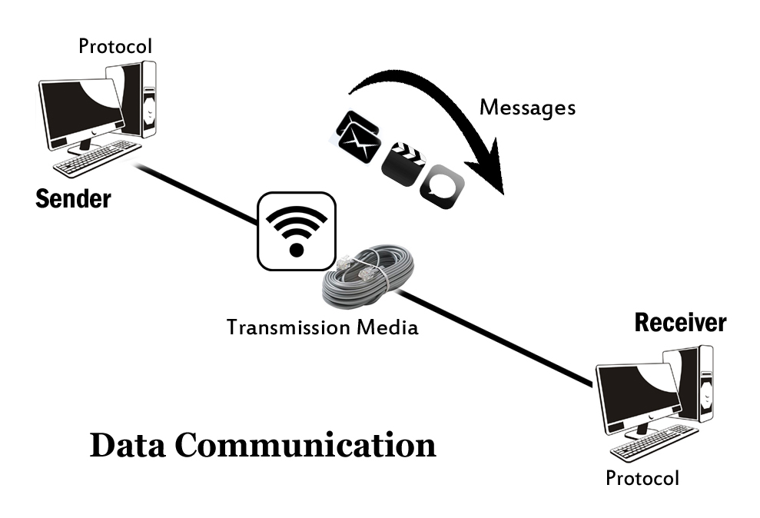
Elements of Data Communication
5 elements of communication:
Message
Sender
Receiver
Medium (Communication Channel)
Encoder & Decoder

Slide 11
Quality of Communication
Communication between individuals is determined to be successful when:
For data network, the same basic criteria is used to judge the success of communication
Meaning of message understood by recipient
Meaning of message intended by sender

Slide 12
Communicating over Networks
All networks have four basic elements in common:
Protocol
Rules that govern how the messages are sent, directed, received and interpreted.
The units of information that travels from one device to another over a medium.
Medium
Messages
Devices on the network that exchange messages to communicate with one another.
The way by which the devices are connected together.
Devices
Can be wired or wireless.

Slide 13
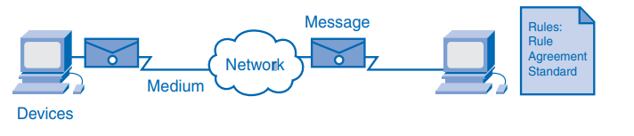
Elements of a Network
Traditionally, telephone, radio, television and computer data networks are four separate networks. Each has its own versions of the four basic elements.
Technology advances has allowed the four networks to be combined together.
This combined network is referred to as a converged network.
Voice, video and data can be carried over the same network.
Eliminate the needs to create and maintain separate networks.

Slide 14
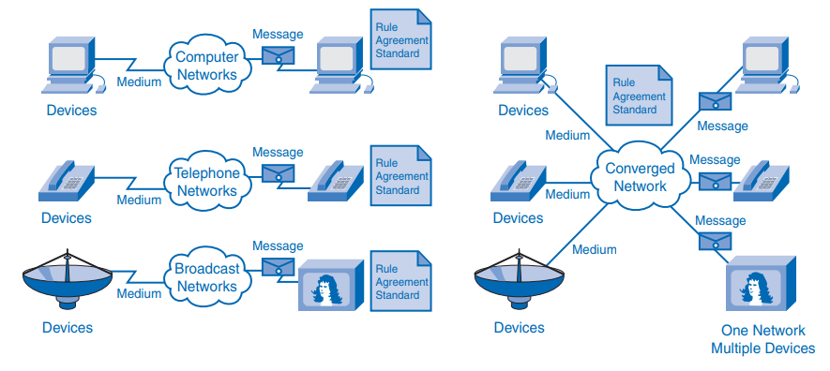
Converged Networks

Slide 15


Examples of today's popular communication tools
Intranet or Social Internet
Chat & Private Messaging
Discussion Forums
Tracking & Case Software
Internal Blogs

Slide 16
Advantages of Networks
Easy Communication and Speed -
Ability to Share Files, Data and Information
Sharing Hardware
Sharing Software
Security
Speed
https://www.brighthub.com/computing/hardware/articles/65406.aspx

Slide 17
Disadvantages of Networks
Breakdowns and Possible Loss of Resources
Expensive to Build
Security Threats
Bandwidth Issues

Slide 18
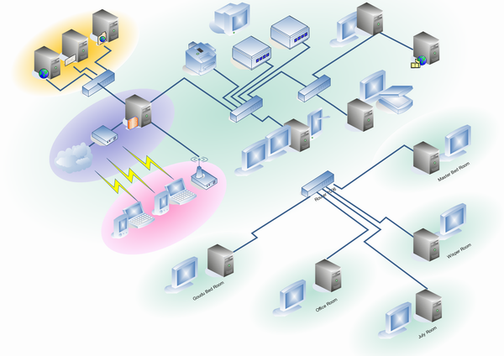
NETWORK DEVICES
Network devices are components used to connect computers or other electronic devices together so that they can share files or resources.
Network devices are also called Communicating devices.

Slide 19
Repeater
Function of a repeater is to receive incoming signals or data packets, regenerate the signals to their original strength and retransmit them.
Repeaters are used when we want to send signals over long distances. (The signal weakens as it travels away from the transmitting node).
Can also be used to reduce the impact of obstructions.
Repeaters basically repeats signals
Physical layer device

Slide 20
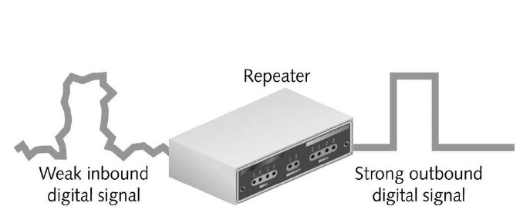
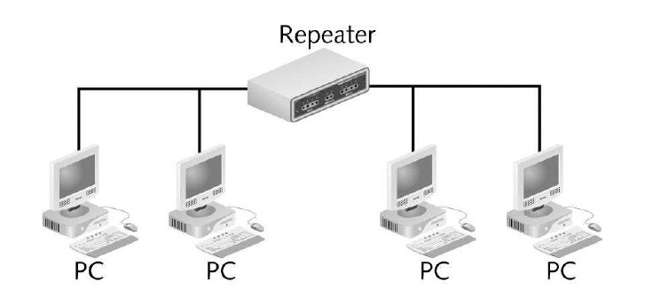

Slide 21
Bridge
Bridges are networking devices that connect two networks
Sometimes it is necessary to divide networks into subnets to reduce the amount of traffic on each larger subnet or for security reasons.
Once divided, the bridge connects the 2 subnets and manages the traffic flow between them.
Bridges examine the Media Access Control (MAC) address of each packet and forms a table.
Bridges operate at only Data Link Layer
Today, network switches have largely replaced bridges.

Slide 22
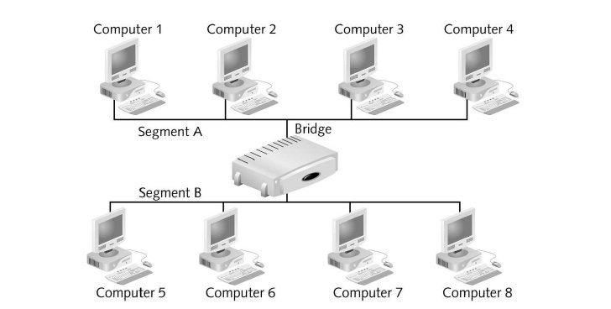
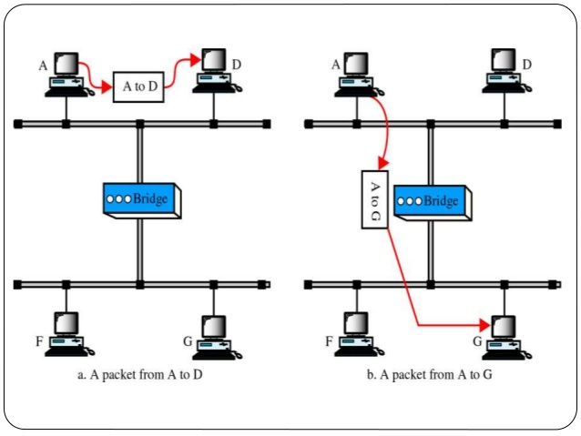

Slide 23
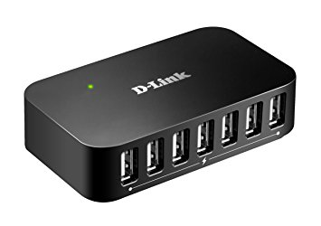
HUB
Hub is a networking device which is used to connect multiple hosts. It is the central point of connection.
Hub is basically a repeater in a star topology.
When a host sends a data packet to a network hub, the hub copies the data packet to all of its ports connected to. Like this, all the ports know about the data and the port for whom the packet is intended, claims the packet.
Copying the data packets on all the ports makes it slower and more congested which led to the use of network switch.

Slide 24
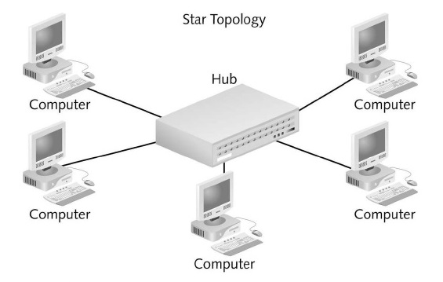
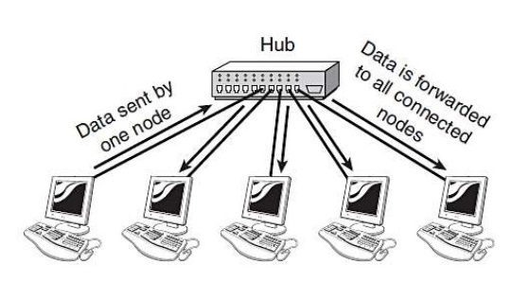

Slide 25
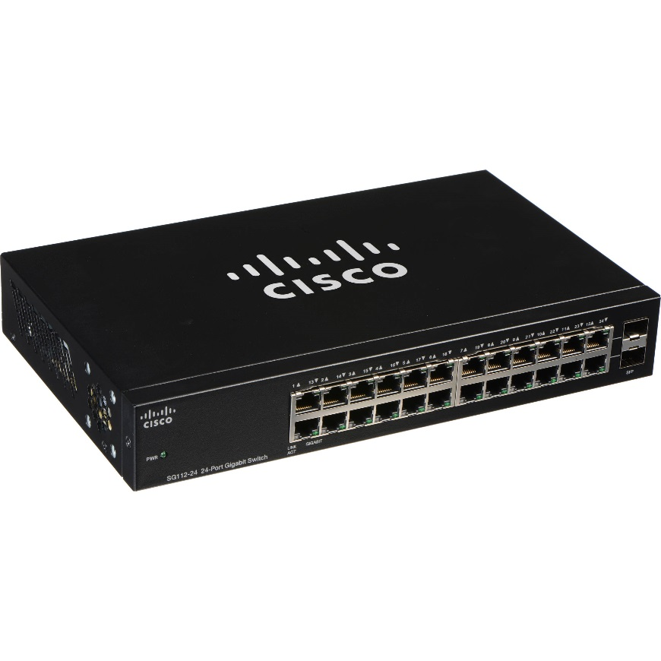
SWITCH
Like a hub, a switch also works at the layer of LAN but a switch is more intelligent than a hub. While hub just does the work of data forwarding, a switch does ‘filter and forwarding’ .
It forwards the data only to the destined device. When a frame arrives at a switch, the switch examines the destination address and forwards the frame out only to the necessary connection.
Operates at Data Link Layer

Slide 26
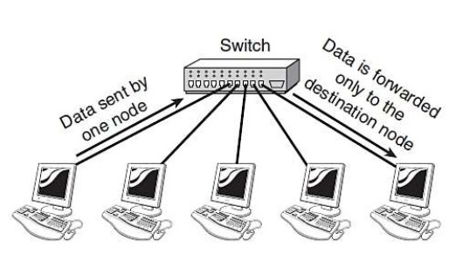

Slide 27
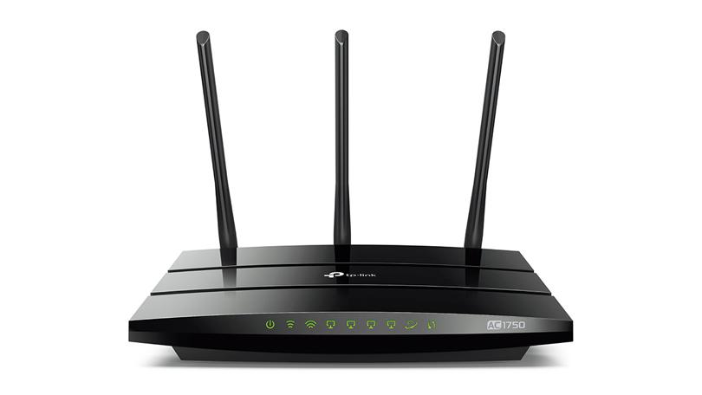
ROUTER
Router is a type of internetworking device.
Routers pass data packets between networks based on network protocol or layer 3 information.
Routers operate at the Network layer.
These devices router the data around the network and can make intelligent decisions to find the best route. They determine the shortest route to a destination and use it

Slide 28
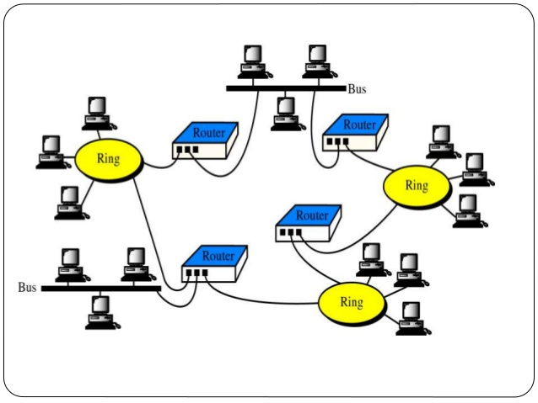

Slide 29
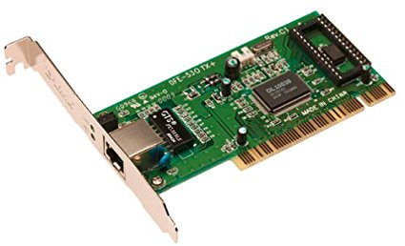
Network Interface Card (NIC)
NIC is a circuit board or card that is installed in a computer so that it can be connected to a network.
As the name suggests it is an interface between your computer and any other network our PC or system is connected to
It is also known as Ethernet card or Network adapter.

Slide 30
Network Architecture
Network Architecture refers to:
Technologies that support the network infrastructure.
Programmed services and protocols that move messages across that infrastructure.
There are four basic characteristics that are addressed by network architecture design to meet user expectations:
Fault tolerance
Scalability
Qualify of Service (QoS)
Security

Slide 31
A Fault-tolerant Network Architecture
Fault-tolerance refers to the ability of the network to:
Limit the impact of hardware and software failures
Recover quickly when failure occurs
Before computer network is invented, the telephone network is already in existence. Telephone network is a circuit-switched, connection-oriented network.
A circuit is established before data transfer. This represents the path to be taken.
Resources are dedicated for each circuit – fixed data rate.
Any failure in the path may cause the connection to be terminated.
Has limited number of circuits. During peak periods, some calls may be denied.
Circuit stays active even if no one is speaking – inefficient use of resources.

Slide 32
Circuit-switching network is not very fault tolerant and can be costly (due to inefficient use of network resources).
Fault-tolerance can be improved by using a packet-switched, connectionless network.
A single message is broken into multiple message blocks called packets.
Packet contains address information of the sender and receiver.
No path needs to be established before data transmission (connectionless).
Different packets belonging to the same message can be sent through the network along various paths.
The original message will be reassembled once all the packets arrive at the receiver.
The Internet is a packet-switching network.

Slide 33
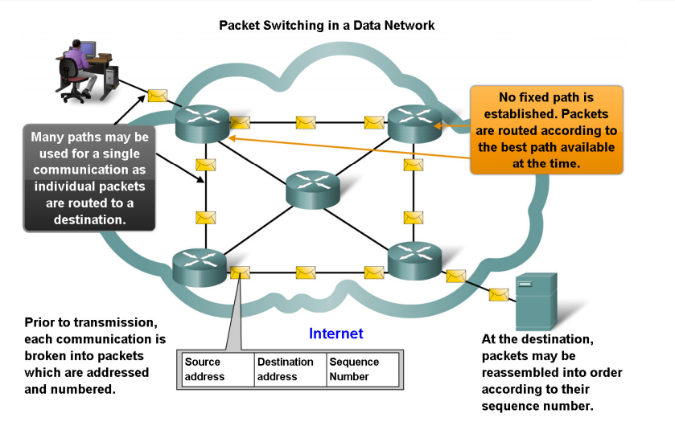

Slide 34
A Scalable Network Architecture
Scalability refers to the ability of the network to expand quickly to support new users and applications without impacting the performance of the service being delivered to existing users.
The Internet architecture is scalable due to the following characteristics:
It has a hierarchical layered structure for addressing, naming and connectivity service.
It uses common standards and protocols.

Slide 35
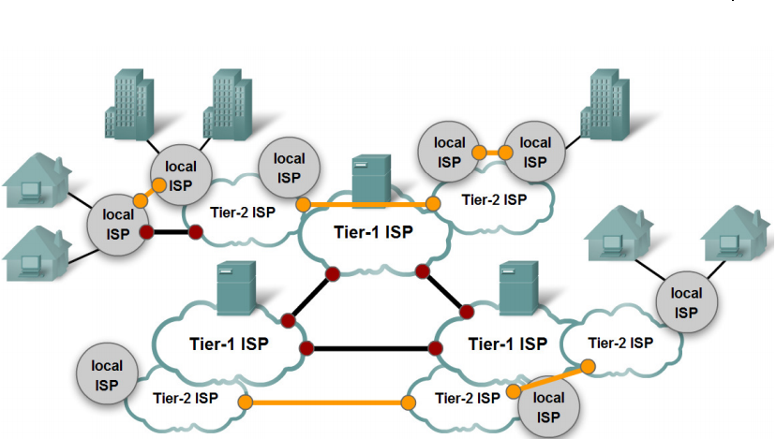

Slide 36
Providing Quality of Service (QoS)
QoS indicates the performance level of the services offered through the network.
The key concept behind providing QoS is to manage the utilization of network resources.
Applications that have certain quality requirements should be given more priority to use network resources.
In the situation where network resources are not sufficient, low-priority packets can be delayed or dropped.
There are various techniques to implement QoS in the Internet. One way is to use priority queue at the network routers.

Slide 37
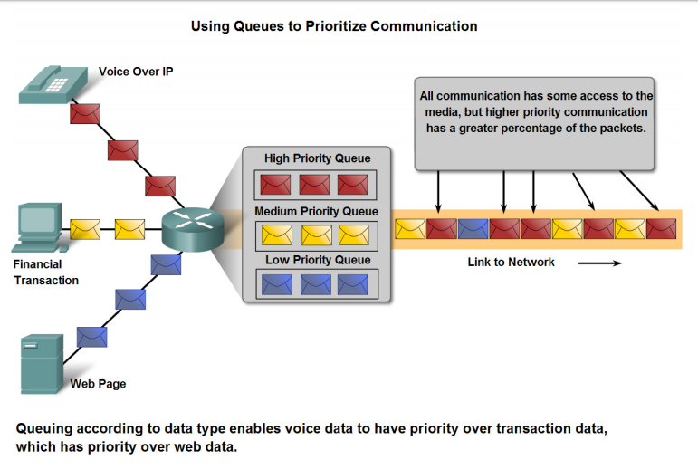

Slide 38
Providing Network Security
The Internet nowadays are used for exchanging confidential and business critical information.
Two types of network security concerns that must be addressed :
Network infrastructure security – physically securing the network devices and preventing unauthorized access.
Content security – protecting the information contained in the packets while being transmitted over the network and while being stored on network-attached devices.

Slide 39
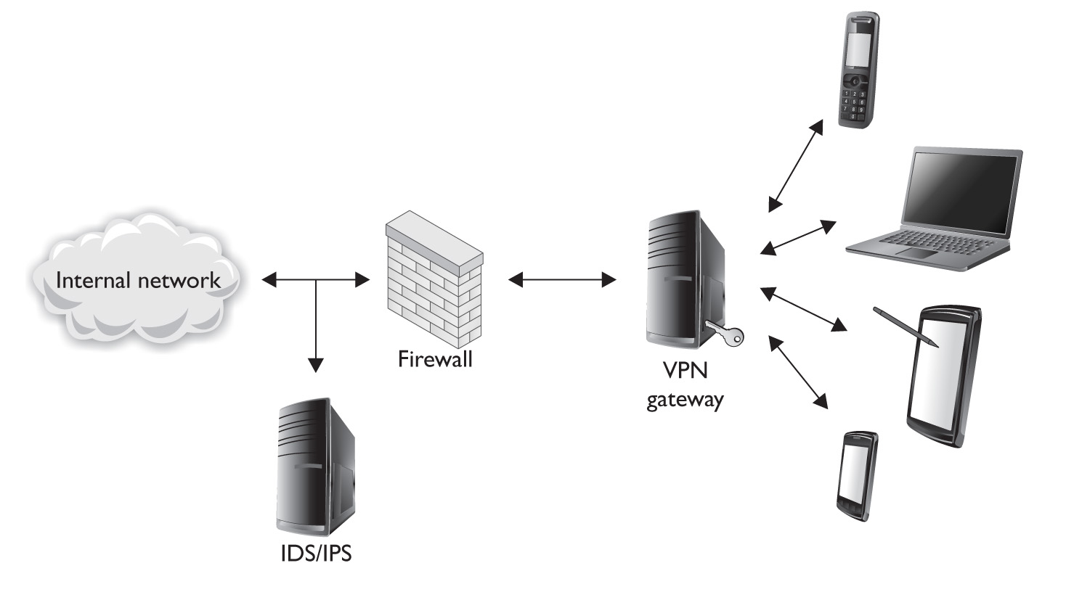
Security measures taken in a network should:
Prevent unauthorized disclosure or theft of information – ensuring confidentiality
Prevent unauthorized modification of information – ensuring integrity
Prevent denial-of-service (DoS) – ensuring availability

